Slide 1
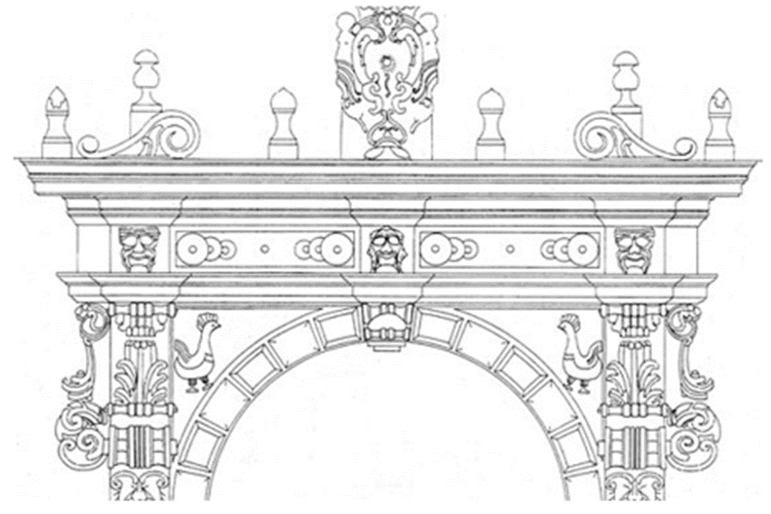
Consumer Law and Technological Innovation
Civil and common law perspectives
Remembering Guido Alpa
LCF – King’s College, LONDON
29th July 2025
Digital Challenges for Consumer Protection
Prof. Gaetano Guzzardi
University of Catania – Department of Law

Slide 2
The Evolving Digital Landscape
The rapid spread of new technologies has profoundly altered traditional market logics and reshaped the global geopolitical order
The pandemic accelerated the consolidation of tech giants' dominant positions due to the unsuitability of traditional supply channels for social distancing
Some digital capitalists aim to establish a lawless space

Slide 3
The "Onlife" Reality
The Internet of Things has permeated the physical world, blurring the lines between real and cyber realms
The term onlife* expresses this collapse of boundaries between the physical and digital
*L. Floridi, The Onlife Manifesto. Being Human in a Hyperconnected Era, Cham, 2015.

Slide 4
Digital Platforms and Multi-Sided Markets
Digital platforms
Provide infrastructure, pre-establish operational conditions, and contractual terms, giving rise to "multi-sided markets"
Orchestrate complex economic operations through sequential, autonomous legal relationships

Slide 5
Data Generation and
Behavioural Advertising
Digital platforms generate wealth and value through continuous, large-scale tracking, profiling, and extraction of voluntarily or implicitly released user data
Collected data is processed in line with "behavioral advertising" principles, reflecting the expectations of the platform’s commercial side
Technological enthusiasm must not overshadow the caution required, given technology's capacity to govern entire markets

Slide 6
Algorithmic Control and
Data as a Commodity
Continuous profiling enables multinational platforms to set priorities and select content based on subjective trends and planned profit objectives.
Data has become a principal commodity: a non-rival, inexhaustible source of reusable information
“Personal data cannot be regarded as merchandise on par with products and services“*
*G. Alpa, Sul potere contrattuale delle piattaforme digitali, in Contratto e impresa, 2022, 723

Slide 7
Consent and Surveillance Capitalism
Accept or Refuse and Subscribe choice
Every network access leaves "digital fingerprints" from which "surveillance capitalists" extract "behavioral surplus knowledge"
In the infosphere, we are our information

Slide 8
The Dark Side of the Digital Revolution
Leveraging targeted advertising and neuromarketing
Web giants actively shape user behaviour online to generate "predictive" data and maximize profits
Unpredictable, spontaneous user behaviour equates to lost revenue
Optimistic views exist: e.g. the “European data space“ promoted by the Data Governance Act

Slide 9
Digital Humanism and the Reputation Economy
A new "digital humanism" must set ethical parameters for technological development to safeguard human traits, recognizing that humans govern technology
The digital market heavily relies on reputation, with users trusting reviews: a wiki spirit* of active user collaboration.
Risks in the reputation market (now the review economy)
*G. Alpa, Sul potere contrattuale delle piattaforme digitali, in Contratto e impresa, 2022, 723

Slide 10
Regulating Online Reviews
The "Omnibus Directive" (Dir. EU/2019/2161) aims for greater transparency in online markets by regulating the "online review market"
Platforms must clarify measures for authentic reviews or state if reviews are "unverified"
Publishing unverified or untruthful reviews is an unfair commercial practice

Slide 11

AVERAGE CONSUMER
Recital 18 UCPD 2005/29/EC of 11 May 2005
takes as a benchmark the average consumer, who is reasonably well-informed and reasonably observant and circumspect, taking into account social, cultural and linguistic factors, as interpreted by the Court of Justice.
The average consumer test is not a statistical test

Slide 12
HEROIC FIGURE or
UNREALISTIC BENCHMARK?
there is a considerable amount of research which reveals that most consumers have none of these characteristics
… Casually observing and uncritical average consumer?
… or Decision maker under risk …
The “average consumer” is unlikely to be the average European consumer, but will in most cases relate to“the average of a certain national or local market”

Slide 13
The Evolving “Average Consumer” in the Digital Age: Challenges and Reconceptualization
Individual decision-making can be distorted by cognitive biases*
Central role of reputational mechanisms in shaping consumer choices within the digital marketplace
Emergence of a "judging community" fostering a form of solidaristic behavior among consumers.
*Court of Justice, 14 Nov. 2024, c. 646/22, Compass Banca SpA / AGCM

Slide 14
The Evolution of Digital Contracts
Platform general terms and conditions function as extensive regulatory manuals, extending beyond individual transactions
click-wrap contracts (explicit acceptance) and browse-wrap models (implied acceptance, potentially leading to "sheer ignorance" of terms)
From homo loquens to homo videns*
* G. Alpa, Contratti a distanza. Prime considerazioni, in Contratti, 1999, p. 848 ss.

Slide 15
Pre-Contractual Duties and Ethical Imperatives
Virtual absence of "duties of fair dealing" in North American pre-contractual phases contrasted with the need for rigorous evaluation in the European digital space
Challenges in transplanting and adapting these solutions to European territories, accounting for distinct legal orders (e.g., data protection, consumer rights, competition)

Slide 16
… while the future may be digital, it must, first and foremost, be human !
Thank for your attention !
GAETANO GUZZARDI
gaetano.guzzardi@unict.it

